Slide 1
Assignment 3
Create subdir project with two projects:
widget application
load search pluigin
choose target directory
enter file extensions, size (Kbytes, no larger than) and age (days, no older than)
display search result (list of all files) received from plugin
plugin library
develop interface to interact with application
search files using multi threaded filter-map pattern (QT Concurent)

Slide 2
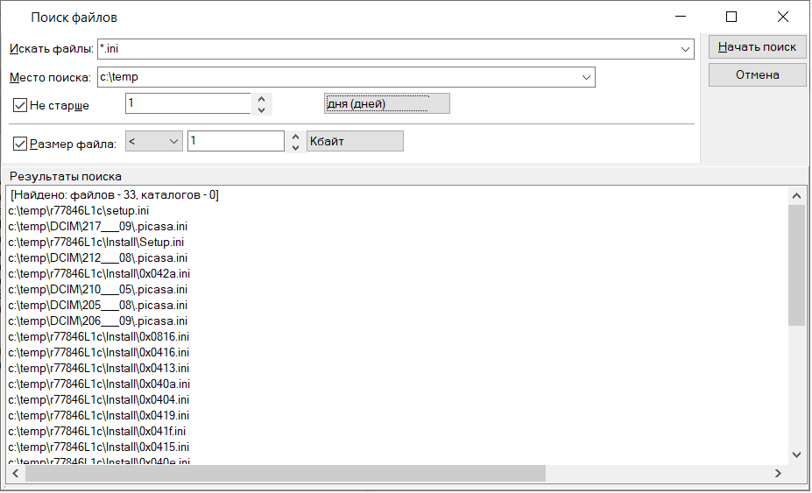
Assignment 3

Slide 3
Assignment 3 checklist
Subdir project with application and plugin
App's GUI: user can select directory
App's GUI: user can define filters to file search
App's GUI: user can see list of appropriate files after finishing search
Application can fund and load plugin with suitable interface
Plugin contains interface class shared with application
Plugin perform multithreading search using QCuncurent filter-map concept
User can cancel search at any time
If user cancel search app must display list of filtered files found so far
each bullet cost 2 points (meaning each unrealized bullet decreases max exercise credit of 25 by 2 points)

